Slide 1


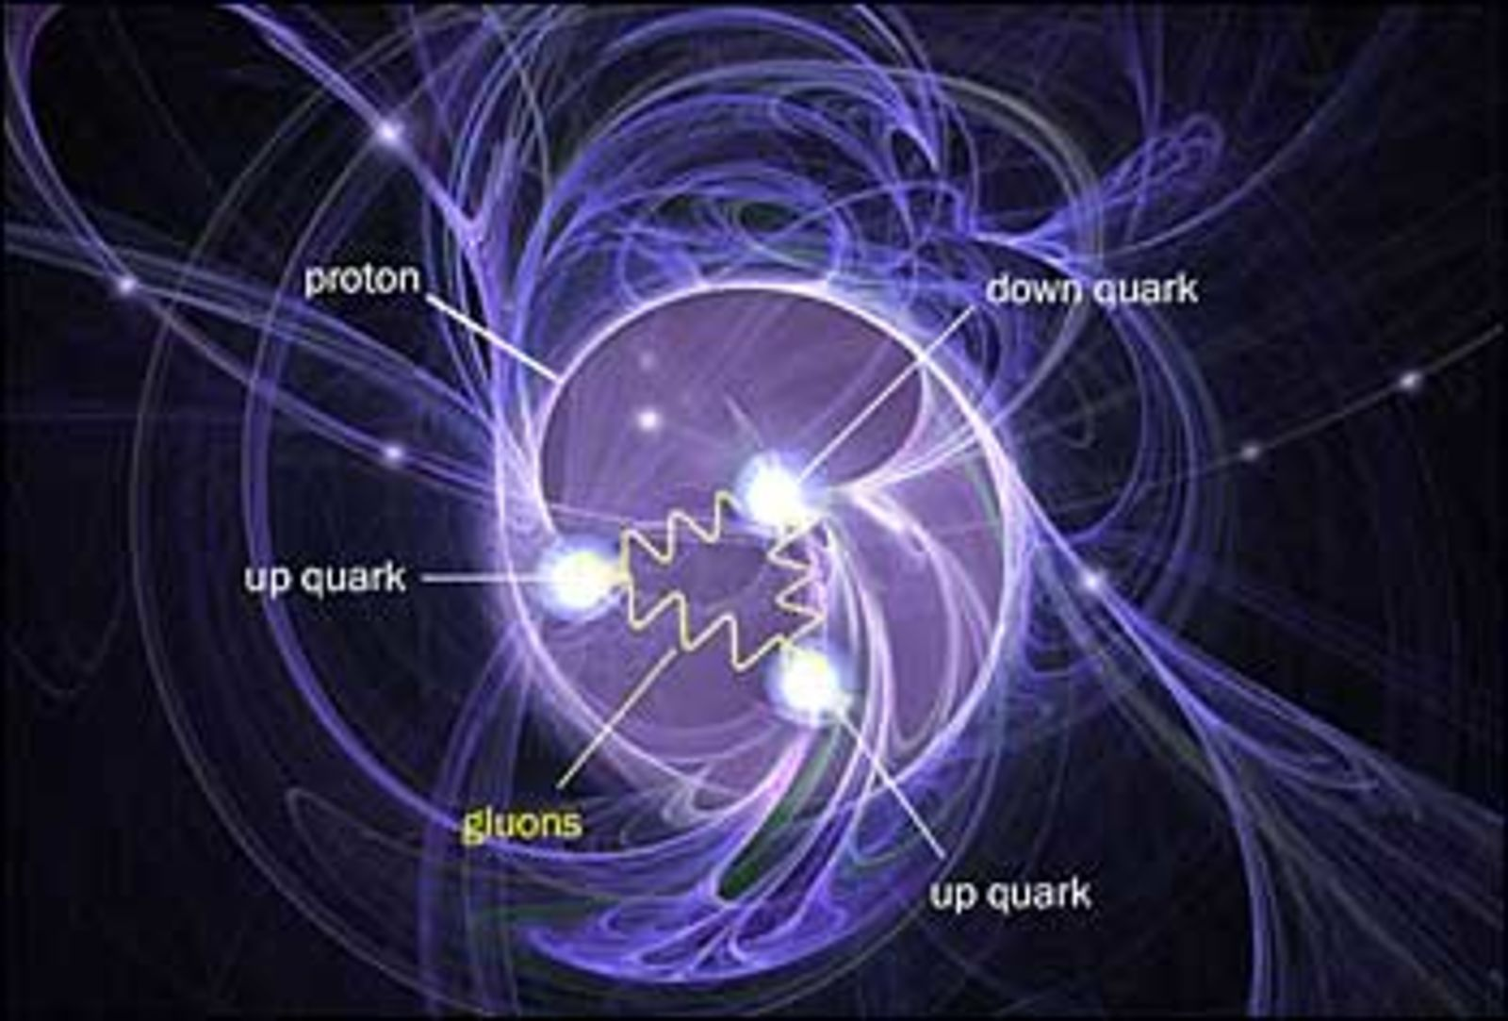
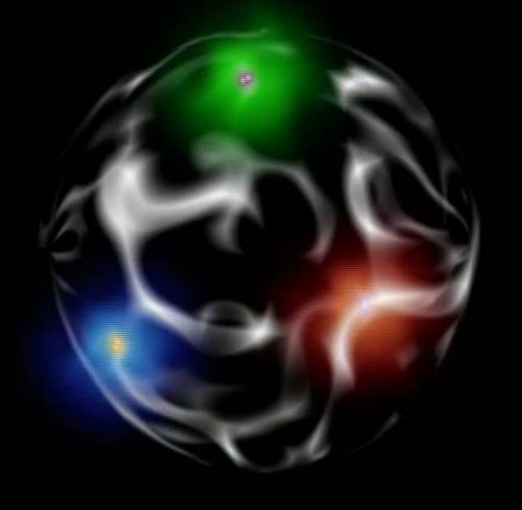
Hall-B and the
Two Big Mysteries in the Universe
Thomas Jefferson National Accelerator Facility
Confinement: why can’t we see free quarks? Hall-B research will shed light on this decades long mystery
This is what we know: quarks are like at the free end of a rubber band. The more you want to pull them apart, the more energy you have to put in.
If you put enough energy in the system, quark-antiquark pairs will be created to force the “fugitive” quark in a bound state again.
The net result is this: we can never observe a “free” quark. And we don’t know why this is. This phenomenon is known as “confinement”.
A full mathematical description of confinement would be the biggest breakthrough in quantum theory in decades.
The Generalized Parton Distributions parameterize the amplitude for Deeply Virtual Compton Scattering: this is the process of making a photon off a proton using a high energy beam.
Hall-B will have access for the first time to the Energy Momentum Tensor Mass, Angular Momentum, and Force distributions to understand quark confinement.
Artistic rendition of a proton: it is made of ”up” and “down” quarks that exchange gluons. We do not know exactly why we cannot see a quark all by itself but only inside particles like protons, neutrons, pions, etc.
Projected results in the Hall-B CLAS12 detector. By measuring cross sections and polarization asymmetries with percent level precision, we will be able to extract the theoretical distributions that could explain confinement.
How is 98% of the visible mass generated? Electroexcitation studies with CLAS12 will address the critical question.
You may have heard of the Higgs Boson. It is a big deal: the Higgs is the reason why quarks have masses and the first step in understanding where the concept of “mass” comes from.
However quarks contain just a fraction, about 2%, of the mass of the visible universe as we know it. How is the remaining 98% generated?
We suspect that the quark is “dressed” by a cloud of gluons, the particle responsible for strong nuclear force: so a normal quark (left) is the sum of a “bare” quark “q” + possible quark-antiquark pairs and gluon interactions, possibly even gluon balls.
There are 3 quarks inside the proton. Each quark has a mass of approximately 4 MeV (the mass unit used in nuclear physics). But a proton weights 938 MeV. Where does the rest of mass come from? Hall-B will be able to solve the mystery mechanism of hadron mass generation.
The dressed quark mass as a function of its momentum inside the nucleon. This function is the holy grail in understanding how most of the visible mass in the universe is generated, and will be measured in Hall-B during the CLAS12 experiments.

